Slide 1
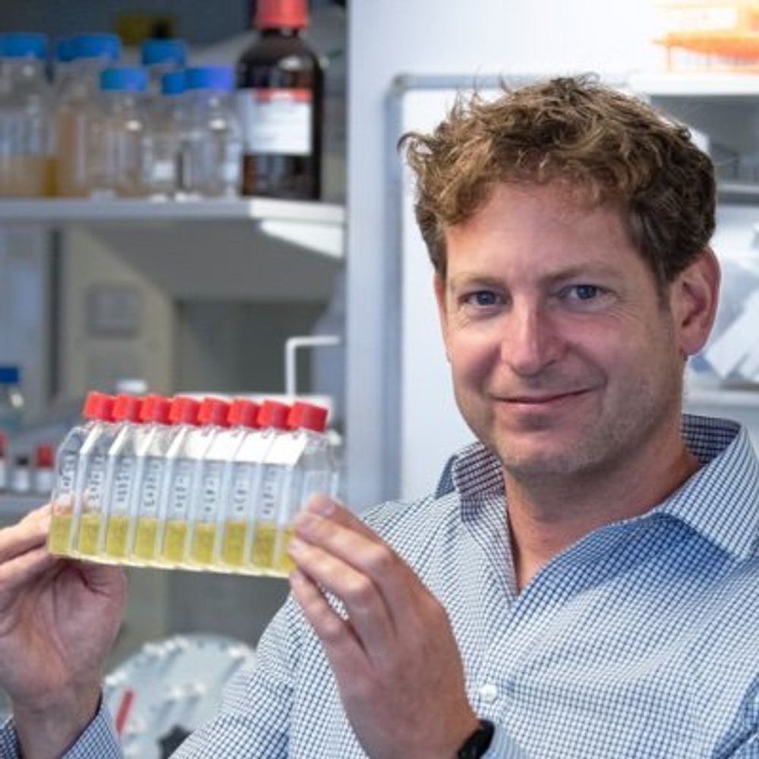
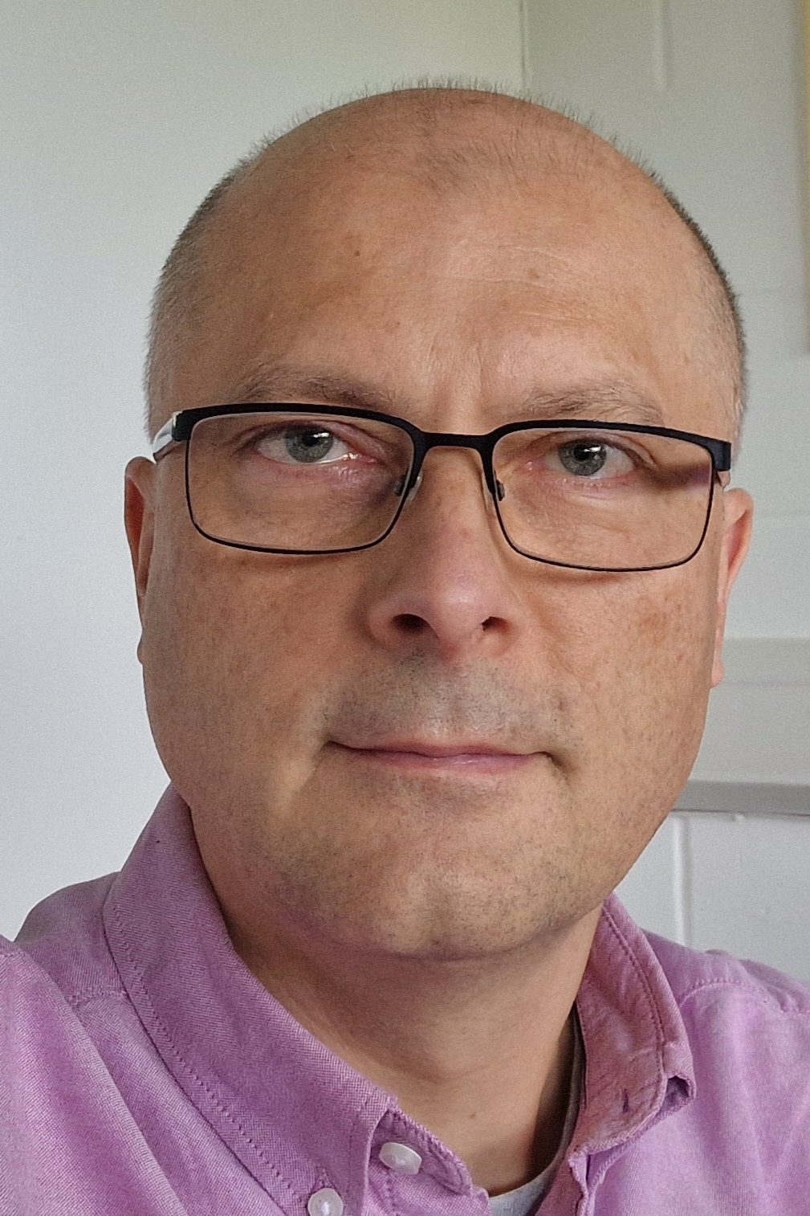
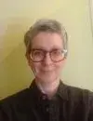
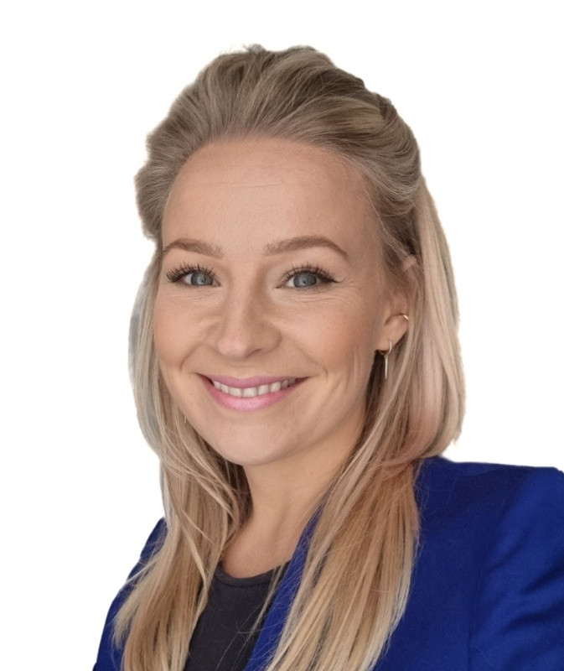



EastBio recruitment 2027
Gerben van Ooijen
EastBio Director
Attila Molnar
CSE Local Lead
Maria
Filippakopoulou
EastBio Manager
Lizzie Leigh
Industry Engagement Manager
Hazel Harrop
Support Officer
Notes:
Welcome to this Q&A around our annual PhD student recruitment cycle for EastBio.
I am… and with me is ….
This will be the first recruitment round of our new funding cycle, the firt intake of student under our new Doctoral Landscape Awards from BBSRC

Slide 2
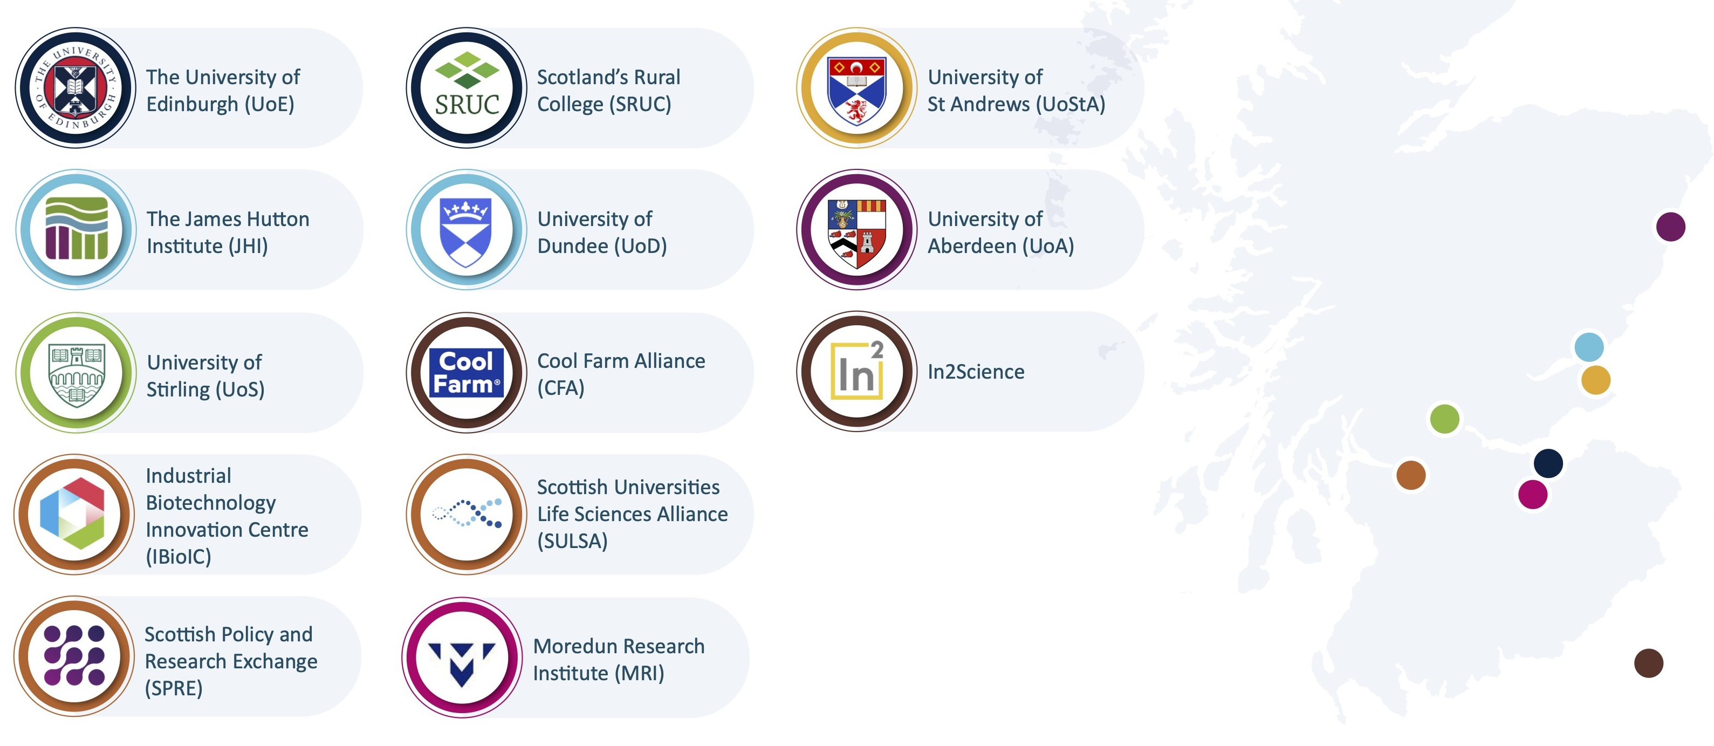
East of Scotland Biosciences partnership
Notes:
As a reminder of the dimensions of eastbio; it is not an Edinburgh only partnership, We have 9 hosting partenrs, where students will be based, and 4 collaboratrove partners that we work with for things like training or industry engagement or widening participation.

Slide 3
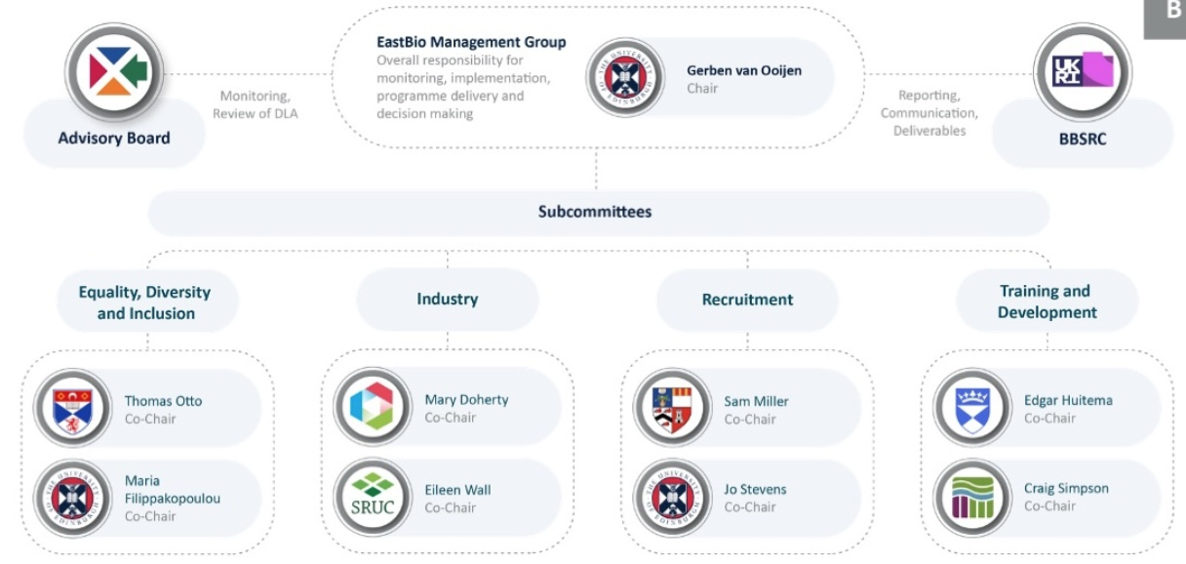

East of Scotland Biosciences partnership
David Smith
Co-Chair
Lizzie Leigh
Industry Engagement
Manager

Slide 4
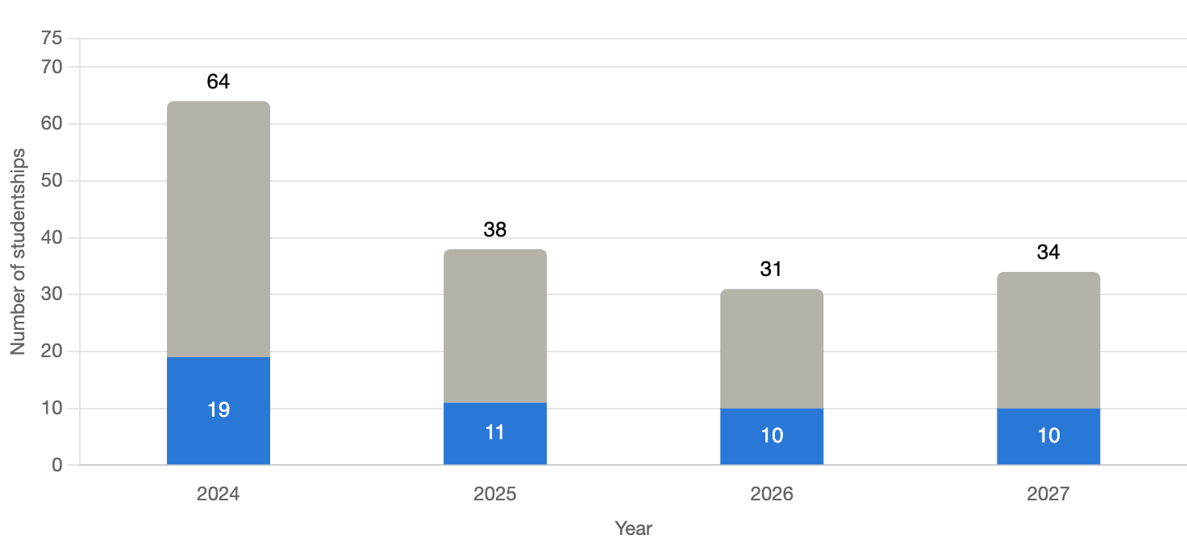
EastBio funding is limited
A new iteration of funding: move from Doctoral Training Partnerships (DTPs) to Doctoral Landscape Awards (DLAs) and Doctoral Focal Awards (DFAs)
We have restricted supervisor eligibility criteria for the upcoming round(s)
Notes:
State how small the funding is; how competitive; expectation management ; excellent candidates might not get selected for interview. Excellent interview performance might not lead to an offer.

Slide 5
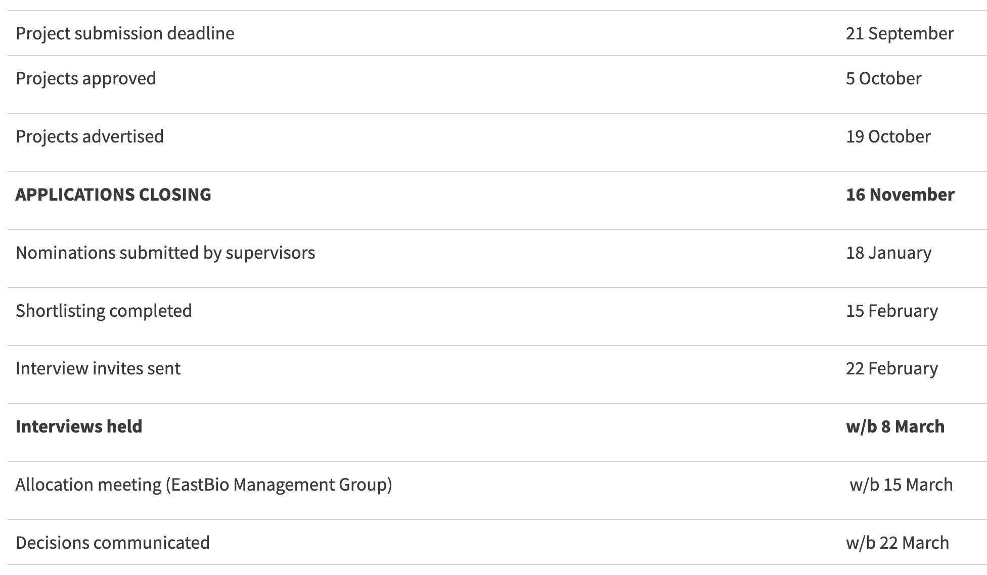
Recruitment timeline
Applications forwarded to PIs 30 November
Notes:
talk through the list.
- I will now go through some of these steps in a bit more detail, to help you nominate the candidate with the best chances of success and to give you the background on our processes so that you know how to best support your chosen candidate.

Slide 6
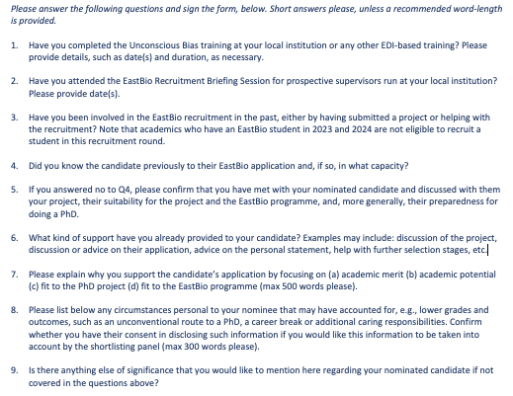
Nominations form
Nomination form will be on website and in email
Notes:
supervisor handbook is linked on it, please have a read. IF you nominate a candidate, you are signing up to be involved in training.
place of study on campus. who do you nominate? Do you nominate at all, because if you do get a student you’re not sure about you will not be aligible the year after.
significant job, and high stakes because it is a big part of the shortlisting. It is not just a form that needs to be there, we actually review these as an integral part of the shortlisting.

Slide 7
Shortlisting procedure
Panel for shortlisting will be led by Attila Molnar; consists of 5-6 PIs from SBS and Chemistry
The purpose of the shortlisting is to assess nominated candidates based on their application materials and the nomination form.
Notes:
note how to select panel members

Slide 8
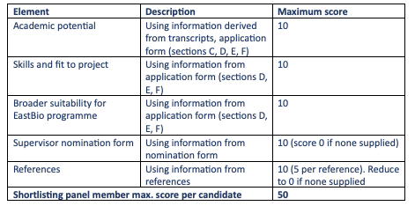
Shortlisting procedure
Panel for shortlisting will be led by Attila Molnar; consists of 5-6 PIs from SBS and Chemistry
The purpose of the shortlisting is to assess nominated candidates based on their application materials and the nomination form.
Notes:
WHEN SUPPORTING A STUDENT WITH THEIR APPLICATION, MAKE SURE THEY COVER THESE AREAS.
They have to explain why they specifically apply to an EastBio studentship. If they do not mention EastBio in their application, they will not make it through. Like with any funding opportunity, you need to explain why you are a good fit to the particular funding source.
the candidates have to make sure the references are submitted in time. It is their responsibility. Without references, they will not make it through.
Without a good supervisor nomination they will not make it through; that is your responsibility to the candidate who relies on you.

Slide 9
Shortlisting procedure
~2 candidates per place will be interviewed (This round, SBS will recruit 8, chemistry 2 places). Any home BAME nominee not on the shortlist will be added.
We use the average score from shortlisting panels to rank the candidates.
Interview list then drafted by local leads based on this ranking, but has to reflect:
Ratio between participating departments
25% CASE studentships (minimum)
30% Overseas candidates (maximum)
EDI data to for equally suitable candidates (only available to lead)
Notes:
age 30 and over; declared disability; postcode at the end of secondary education indicating low participation in higher education; first-generation in family in higher education (as well as carers or care-experienced
At interview stage, your candidates would have a 50% success rate

Slide 10
Interview panels
Interview panels consist of 4 PIs from across the partnership
This year, panels will be chaired by:
Attila Molnar (UoE CSE)
Thomas Otto (St Andrews)
Samantha Miller (Aberdeen)
Notes:
Note how we select panel members. we will interview 80-90 students, in the week of the 10th of March. We will divide these randomly between four panels, that will consist of these people this year, and we work to have inclusive panels for all interviews we carry out.
departmental numbers; 25% CASE; 30% O/S; EDI data to separate equally suitable candidates

Slide 11
Interview panels
Interview panels consist of 4 PIs from across the partnership
This year, panels will be chaired by:
Attila Molnar (UoE CSE)
Thomas Otto (St Andrews)
Samantha Miller (Aberdeen)
Notes:
we will interview 60-70 candidates, in the week of the 16th of March. We will divide these randomly between three panels, we don’t have the full details of panels yet but we work to have inclusive panels for all interviews we carry out.

Slide 12
Interviews
The interview consists of an 8-minute presentation by the candidate, followed by a Q&A with set interview questions.
Eight criteria will be marked from 1-10:
Student presentation
Motivation for a PhD
Academic potential
Fit to project
Critical thinking skills
Broader scientific interest
Fit to programme
General communication skills

Slide 13
Allocation
Panels use identical guidance and scoring criteria; scoring will be normalised per individual panellist and by panel overall.
Offers made after the Allocation meeting with the full EastBio Management Group early April.
We take the top half of interviewed candidates as a starting point, but consider departmental allocations, CASE studentships, Overseas candidates, and EDI data.
For CASE projects: Agreement needs to be signed before offer.
Notes:
This process will conclude in the first week of April.

Slide 14
Questions?
enquiries@eastscotbiodtp.ac.uk

