Slide 1

Training Course for Demonstrators in School of Biological Sciences
Dr John Curtis, FHEA
Academic Lead for Tutors and Demonstrators
Biology Teaching Organisation (BTO)
On arrival - please:
sign attendance record
collect name badge
collect ‘Do & Don’t’ handout
take a Post-it note
Whilst waiting:
Write on Post-it note any concerns you have about demonstrating (anonymous)
At the table – introduce yourself & discuss why you want to be a demonstrator

Slide 2


Housekeeping

Slide 3
Aims of the Training Course
Outline the roles and responsibilities of
  The Biology Teaching Organisation (BTO)
  The Demonstrator
Discuss skills required to be a good demonstrator
Review some ‘dos and don’ts’ of being good a demonstrator
Provide general guidance on marking of students’ work
Discuss pastoral care of students

Slide 4
You will be sent:
Link to the SBS Demonstrators’ Handbook
Notes:
Handbook is a hyperlink to the page

Slide 5
Biology Teaching Organisation (BTO)
Dr Julia Richardson - Director of Teaching
Alice Heatley - Academic Administrator
Dr John Curtis – University Teacher & Academic Lead for Tutors and Demonstrators
Zoe Grove, Aga Biel, Coleman Kerr, Niamh Brown, Paloma Arredondo & Edward Grady – Student Advisors
Banhi Mukherjee – Resources Manager
Technicians (varies according to the course)
Secretaries (varies according to the course)
Course Organisers & Teaching Teams
Notes:
Point out that Banhi deals with contractual matters, I can provide general help/advice to demonstrators. Most contact with Floor leader & technicians

Slide 6
Other Teaching Organisations (TO)
See SBS Demonstrators’ Handbook for contact details:
BTO Biology Teaching Organisation
GTO Geoscience Teaching Organisation
CTO Chemistry Teaching Organisation
BMTO Biomedical Teaching Organisation

Slide 7
Why do you want to be a demonstrator?
Notes:
Get them to share what they discussed when waiting

Slide 8
Roles and Responsibilities I:
The Department (BTO)
Laboratory Demonstrating

Slide 9
Departmental (BTO) Responsibilities
Contractual arrangements – contracts & payment
Ensure safe working practices
Provide a line of authority
Laboratory guides – course books provided (most courses also provide demonstrators’ notes)
Provide clear assessment criteria for marking assignments
Provide information on any student with a Schedule of Adjustment (through the Lab Floor-leader, via the Course Organiser)
Notes:
New for Dec 2017 - Provide information (through the Lab Floor-leader, via the Course Organiser) on any student with a Schedule of Adjustment. Explain what we mean by SoA and what it may mean for the demonstrator.

Slide 10
Contractual Matters
Banhi Mukherjee
Resources Manager
BTO
Email: bto.demonstrators@ed.ac.uk
https://www.wiki.ed.ac.uk/display/intranetpublic/Demonstrating+and+Tutoring

Slide 11

Demonstrator Training
28th May 2025
BANHI MUKHERJEE

Slide 12

Demonstrating
Demonstrating is applicable to only PHD students currently studying in the university.
For postgraduate research students registered at the University, tutoring and demonstrating must not impede the successful completion of the students’ own degrees.
Work may take the form of:
assisting in practical sessions (online and/ or in person)
workshops (including coding)
assisting with tutorials
marking

Slide 13
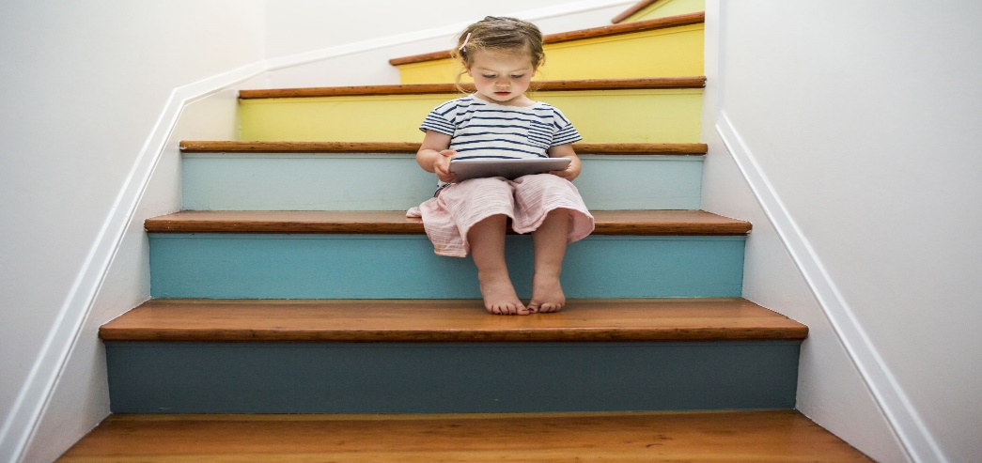
Steps to becoming a demonstrator
Register to be a demonstrator: Registration Form (Requires EASE login) - to indicate which courses suit your area of expertise.
Attend the Demonstrator Training Course.
Demonstrate your eligibility to work in the UK by presenting appropriate documents (PASSPORT and VISA) in person (at the BTO office,– will email to arrange a time)
You should include your National Insurance number (you must apply for one if you don’t have one – from the website: https://www.gov.uk/apply-national-insurance-number). You can register before receiving your NI number, and let us know when you have been given one

Slide 14




VISAS
Student visas

Slide 15



Students on visas have a limited number of hours they can work in any one week.
It is your responsibility to ensure you do not work more than your limit.
The hours you are allowed to work covers the total number of hours
worked over all jobs
(paid and voluntary).

Slide 16





Signing up to demonstrate
This is a commitment
You must be Prepared – read the course material beforehand –
you are being paid for 45 mins prep time before each NEW practical
Arrive in good time (approx. 10 mins before the start of the practical).
We sometimes ask for reserves at short notice.
If you are unable to attend for some reason – you MUST contact us
  For 1st and 2nd year courses which are coordinated by the BTO, contact Banhi Mukherjee(bto.demonstrators@ed.ac.uk – put “URGENT” or “IMPORTANT”
  in the title of the email), or message via Teams
  For other courses contact your lecturer/floor leader responsible for your recruitment.

Slide 17



School of Biological Sciences Contracts
For demonstrators who are current students: you will be issued with a contract until the end of your period of study.
We recommend no more than 6 hours per week. Please discuss this with your principal supervisor.
Students on some research scholarships are limited in the number of hours they are permitted to work (e.g. BBSRC). It is your responsibility to ensure you do not work more than your limit.
If you are expecting a baby, please let us know – you are entitled to maternity leave.
You will be given a staff email address – please use it for all demonstrator communications.

Slide 18


Payments
There are 2 rates of pay at the BTO:
  For demonstrating (grade 5)
  For marking (grade 6).
Submit the relevant timesheets via PEOPLE AND MONEY
  Timesheets should be submitted no later than 30th or 31st by last day of the following month.
  Timesheets need to be approved on-line, so we need time to do this before the Finance deadline (often 5th of the month)
  Please do not modify an approved timecard. The timecard gets locked.

Slide 19

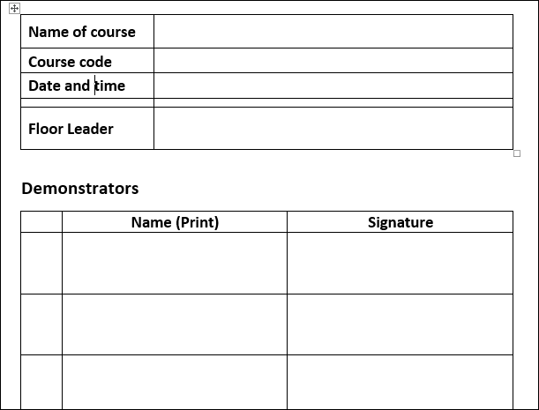
Timecards
Please make sure you sign in when you arrive in the lab, and note if you have to leave early
If you haven’t signed in, we cannot verify you have demonstrated at that practical, so you will NOT get PAID!

Slide 20


TIMECARDS
It is your responsibility to complete monthly timesheets in PEOPLE& MONEY
  You can find the demonstrators handbook in the below link:
  https://www.wiki.ed.ac.uk/spaces/intranetpublic/pages/106310064/Demonstrating+and+Tutoring
  For any other query please email to bto.demonstrators@ed.ac.uk
  BUT DON’T ask the Floor Leader!

Slide 21

PEOPLE&MONEY
You need to use your staff UUN to log into PEOPLE&MONEY (through MyEd)
You will need a password, which you have to get from Is helpline by mailing to UniDesk Mailbox 53 IS.Helpline@ed.ac.uk or from any Library Helpdesk support in campus.
Your BTO contract can be seen in your staff P&M account after you can login to it.

Slide 22

TIMECARD
Video link on how to create an timecard for an employee:
https://media.ed.ac.uk/media/Demo+for+Employees+-+Creating+Time+Cards/1_16eaec4q
Make sure you have completed all demonstrating for the month BEFORE submitting the timecard for the month.!
If you have carried out marking, select the appropriate task and I will put through the alternate rate on approval.

Slide 23


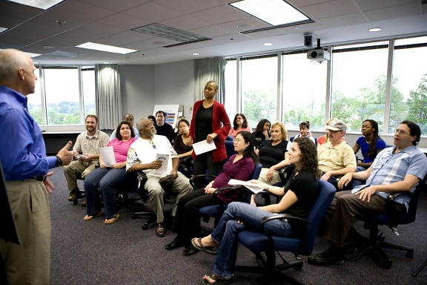
Payments
Submitting all work carried out at the end of the semester may result in you paying a National Insurance fee (a non-returnable tax)
Payments are made direct to your bank account around the 28th of the following month.
You will be paid 3 hours for this training course when you submit your first timesheet – please remember to add it in!
  [Make sure your name appears on the list of attendees.]
This Photo by Unknown Author is licensed under CC BY-SA

Slide 24

Feedback
We will try to provide you with feedback on your work.
There is usually a feedback session held at the end of Semester 2.
If emailing us about a query, please use:
bto.demonstrators@ed.ac.uk

Slide 25



What are the most important thing you have learned in the last few minutes?
BEFORE you start working as a demonstrator
1. Complete your RTW and contract
and
Once you have your contract, use your STAFF UUN and password and check you can get into People & Money
And
Use your STAFF EMAIL ADDRESS for all demonstrator communications

Slide 26

Any questions about job grades/rates of pay should be answered in the BTO page where you can find all the details of how/when/what
Any questions about not getting paid/tax etc. contact payroll
Any issues with accessing historical payslips/P60 contact UniDesk.
For any other problems accessing P&M contact HRHelpline@ed.ac.uk

Slide 27
Which of the following is the most important when Applying to be a demonstrator?
Group activity
Good organisational skills
Good timekeeping skills
Good attitude to teaching
Good observational skills
Prior knowledge of the practicals
Good communication skills
Notes:
Here you could argue the most important is having a good attitude to wanting to teach. The other skills can be developed and learned but attitude is part of the personality. Good communication skills would be desirable but can be developed with willingness to learn and to teach.

Slide 28
Which of the following is the most important when in the lab demonstrating?
Group activity
Good organisational skills
Good timekeeping skills
Good attitude to teaching
Good observational skills
Prior knowledge of the practicals
Good communication skills
Good preparation for the practical
Notes:
ALL are important but you could argue the most important is having good knowledge of what is being done in the lab. However a good attitude to teaching is close behind, but preparation is essential and even a great attitude to teaching and to the students will not be enough if they have not prepared. Good communication skills would be desirable but can be developed with willingness to teach.

Slide 29
Roles and Responsibilities:
Safety in Wet Laboratories
What you would do if one of your students did the following when you are their demonstrator?
  They set a beaker of alcohol on fire
  They feel faint/unwell
  They spill a bacterial suspension on the bench
  They are using a mobile phone in the lab
Notes:
Make it clear why this is being covered. This came up at the demonstrator feedback session 2016. They have a different role in the lab when demonstrating than they do in their own research lab. thus they need to consider what they will do if one of the students that they have in their group has one of this issues. They also need to setting a good example – not passing on any bad habits they may have in their own resaerch lab.

Slide 30

Short break
What concerns, if any, do you have about being a demonstrator?
Write on a post-it note
Notes:
Get them to spend a few minutes discussing this and then ask them to write their reasons on a post-it and put on the wall when going out for coffee
New for 2017 square post-it for concerns that I can address. Remind them it is anonymous

Slide 31
Review of concerns about being a Demonstrator
Notes:
Look at the post-its and see if common reasons given.
Look over concerns – common ones?

Slide 32
Roles and Responsibilities II:
The Demonstrator
Laboratory Demonstrating

Slide 33
Roles of the Lab Demonstrator
Will include helping students:
develop technical & observational skills
communicate with their peers
understand the purpose of the practical
analyse data (including calculations)
answer questions
May include:
gathering material for student feedback sessions e.g. class data
marking lab reports, lab books or ICAs
Notes:
Marking ICA would probably be something that may be offered but would be in addition to the lab demonstrating.

Slide 34
Overview of Your Responsibilities:
The Team
Preparation
Organising your Time
In the Lab (dos and don’ts)
Pastoral Care
Notes:
Will be covered in the following slides

Slide 35
The Team: Course Contacts
All names and contact details for the following staff should be in the course book
Course Organiser
Course Administrator
Practical or Floor Leader
Technicians

Slide 36

Demonstrators are part of the Teaching Team
Wet Laboratory Demonstrating
Floor Leaders
Students
Demonstrators
Technicians
Notes:
Weight of arrows to indicates the degree of interaction between the various people in the lab team. It is mainly to illustrate that the demonstrators have the major interaction with the students. DoS is in brackets because they may not be involved with a particular teaching team but they may have a directee on the course whom they ‘support’.

Slide 37
Preparation
Preparation
Preparation

Slide 38
Preparation
Familiarise yourself with the course book / practicals guide and check:
- what students are expected to gain from the practicals (Learning Outcomes)
- for additional material front and / or back
the summary of lectures (help to make connections between the practicals and lectures)
Attend course-specific practical preparation session(s) (compulsory)

Slide 39
Preparation cont.
Familiarise yourself with equipment or material before the class, ASK the floor leader to go over it / them with you if unsure (at training sessions or before the practical starts)
Always read the schedule for the practical before the practical (and read material in text book etc. to support the topic as you require during your preparation)
Always read the demonstrator guide in advance

Slide 40
Bring with you…
Demonstrator guide (guard it!)
Practical guide
Your own notes (if you have prepared any)
Provided…
Name badge
Blue lab coat
Blank paper
Pens, pencils, permanent marker pens & calculators
Props (as appropriate)

Slide 41
Warning!
Demonstrating is hard work
Arrive 5 - 10 minutes before the start
Don’t arrive at the lab hungry!
Notes:
Don’t arrive at the lab hungry! As you will not be able to take a coffee break!

Slide 42

Organising your Time

Slide 43
Organising your Time
Ensure your supervisor is happy for you to take time out to demonstrate!
Apportion your time between teaching and research - be realistic
Remember to factor in the preparation time for teaching
Check if marking is required (or optional)

Slide 44
Teaching is a Commitment
Plan your experiments around:
  Teaching
  Preparation
  Marking Commitments
Keep a diary and block out times for teaching AND marking AND preparation too!!
If you have to cancel your session the day before or on the day of teaching, let Banhi Mukherjee know immediately by emailing bto.demonstrators@ed.ac.uk Put URGENT in subject line and flag as ‘Important’

Slide 45
You are in paid employment -
It is normally not acceptable to cancel at short notice if you are e.g. …
Running an experiment
Going on holiday
Undertaking field work
Attending meetings or seminars
Going to a conference
Rather, discuss in advance, tell Banhi the times you can’t do so it can be agreed and a replacement found

Slide 46
1. What are practicals for?
2. What good and / or bad demonstrator experiences did you have as a student?
Group activity
Discuss:
Notes:
Group activity. Give them a few minutes to discuss and then share thoughts

Slide 47
What are practicals for?

Slide 48
What are practicals/workshops for?
e.g. To:
Develop technical skills
Increase engagement with course material
Promote teamwork
Build a sense of community
Consolidate subject knowledge
Improve cognitive skills
Talk about science
Develop data collection & record-keeping skills
Practice data analysis
Provide immediate feedback
Group activity
Notes:
Group activity. Give them a few minutes to discuss and then share thoughts
Improve cognitive skills : getting them to think about the results they get (or sample data provided) and what it means.

Slide 49
What good and / or bad demonstrator experiences did you have as a student?
Notes:
Raise hand if what to share
To emulate or avoid as appropriate in own teaching.

Slide 50
Skills for Demonstrating

Slide 51
Some ‘Do’s and Don’ts’ of Demonstrating
Do = ✓
Don’t = X
Unsure = ?
Notes:
In times of covid course - Exercise to consider on their own initially then I will go over answers

Slide 52
Some Do’s and Don’ts (part 1)
make a student feel silly for not knowing something
if you don’t know, guess
spend more time with students having difficulties
stay near your benches
use your mobile phone when in the lab
change the order of doing the practical if you think you have a better way
write on a student’s lab/course book
ask students questions
wait for students to ask you questions
leave when your students have finished
Notes:
Give a few minutes for them to think of their answers

Slide 53
Some Do’s and Don’ts (part 1)
X
X
?
✓
X
X
?
✓
X
?
make a student feel silly for not knowing something
if you don’t know, guess
spend more time with students having difficulties
stay near your benches
use your mobile phone when in the lab
change the order of doing the practical if you think you have a better way
write on a student’s lab/course book
ask students questions
wait for students to ask you questions
leave when your students have finished

Slide 54
Some more Do’s and Don’ts (part 2)
be authoritarian
come prepared
spend more time with keen students
be friendly
if you don’t know something - ask
stop talking to students if the floor leader makes an announcement
give answers to set questions
contradict the floor leader
look out for hands going up
keep your word
Smile ☺ !
provide help with in-course assessments (ICAs)
Notes:
Give a few minutes for them to think of their answers

Slide 55
Some more Do’s and Don’ts (part 2)
X
✓
X
✓
✓
✓
X
X
✓
✓
✓
X
be authoritarian
come prepared
spend more time with keen students
be friendly
if you don’t know something - ask
stop talking to students if the floor leader makes an announcement
give answers to set questions
contradict the floor leader
look out for hands going up
keep your word
Smile ☺!
provide help with in-course assessments (ICAs)
Notes:
Nb new addition ICA for 2018

Slide 56
Wet Lab Demonstrator Roles (1):
Ensure that when in the lab ……..
You read & sign the risk assessment forms
You sign the attendance sheet for payment approval
Your students sign the class attendance sheet
Your students complete any class data sheet(s) provided
You collect class data sheets from your students
Long hair is tied back (yours and theirs)
You and your students are using appropriate PPE
Phones are not used (yours and your students’)
There is no eating, drinking or chewing

Slide 57
Wet Lab (and workshop) Demonstrator Roles (2):
COME PREPARED!
Ensure that you ……..
Encourage good note taking
Help to connect theory / concepts with the practical
Help students develop technical skills
Encourage students to ask questions (not just to answer them)
Work with your students (but be aware of other students too)
Check on progress based on time available
Stretch the ‘high flyers’ with new questions and ideas (if time allows)

Slide 58
What to do if …….
A student arrives very late
Students start to leave the lab very early
A student appears not to be participating in the practical
Notes:
New slide for 2016 as a result of the demonstrator feedback session 2016. Really just want to point out that they should ask their floor-leader on what to do if a student wants/starts leaving early. Could have implication e.g. if an assessment is part of the practical (as in BEE1). Also they may miss something the floor-leader would be doing or saying at the end of the practical. Ultimately we can’t force students to stay but we can help point out what they will miss by leaving early.
Also can’t force students to participate but they should let the floor-leader know as they may want to have a chat with the student.

Slide 59
Demonstrator roles: After the lab……
Give feedback to floor-leader on how the class went (but highlight any problems during the lab)
Return any class data sheets to floor-leader
Help to clear up
Ensure any contaminated / broken pipettes or equipment are reported
Notes:
Offer to help clear up – within the contracted hours but do check what is being kept and what is being thrown away.

Slide 60
Working in Groups
Students normally work in groups (usually in pairs, but course book will give details) - normally students do not work on their own in a lab practical
Let your floor-leader know if you have a lone student in your group
Bring smaller groups together …
When several of your students are asking the same question
When teaching a bench skill to everyone
Notes:
Let your floor-leader know if you have a lone student in your group – don’t just move them into a group of 3, other lone students may be in the lab.

Slide 61
Group discussion
Group activity
Why might a student NOT ask a question?

Slide 62
Why might a student NOT ask a question?
They know the answer or know what they are doing!
They think that they are the only one that doesn’t know
They don’t want to look foolish / appear stupid
They are not interested
Their cultural B/G means they will not ask questions
Their cultural B/G means they don’t know how to ask questions
English is not their first language:
  Thus may be apprehensive of speaking out in front of others
  Lack the vocabulary to formulate the question
They may need longer to process the information before they are in a position to ask a question
They want to go away and find out the answer for themselves
They are so confused / lost that they don’t know what to ask!
Group activity
Notes:
Some reasons (may be others)
Remember to discuss that for some cultures, asking questions of a teacher is unacceptable as they think that the teacher is so good that if they don’t understand something, it is a problem with them! Also in some cultures, they are not taught or encouraged to ask questions or to question what is being said.
Their cultural B/G means they will not ask questions (they don’t want to question authority as it may be seen (in their eyes) that the tutor/professor was not 100% clear in the explanation given)
Their cultural B/G means they don’t know how to ask questions (i.e. this is alien to them, they have not had the opportunity to learn how to ask a question).

Slide 63
Laboratory Record Keeping
Remind students that developing their record keeping skills at undergraduate level can prepare them for their final year Undergraduate project as well as Post-Graduate Taught (PGT) projects
Tell them that record-keeping skills are essential in research
Lab books
We encourage students to keep a lab book for their practicals
You will be told if a lab book is part of their ICA

Slide 64
Pastoral care

Slide 65
Pastoral Care
A student’s behaviour may cause you concern
A student may tell you they have personal problems
What should you do?
All students, Undergraduate or Post-Graduate Taught, will have a Student Advisor (SA)
Students should know who their SA is and how to contact them, check that they do (on their ‘My Student Record’) –
SBS Student Advisors can be contacted by email:
BTOStudentSupport@ed.ac.uk
Non-SBS students should have been allocated a SA by their own School/Deanery
Notes:
They should know how to contact their PT - check that they do – they can request a meeting via their Myed page. Alternatively they can contact the support team.

Slide 66
Confidentiality
You can encourage them to get help from an appropriate source, but you cannot make that contact for them, including their SA
However do let the floor-leader know, or email BTOStudentSupport@ed.ac.uk , if you have concerns about a student (need name or their student number)
Do not guarantee confidentiality
Notes:
However if you have real concerns about a student and you think that they may be at risk, let a member of the BTO or CO/FL know.

Slide 67
Charlie Waller Trust
Information and Training on Mental Health Awareness
www.charliewaller.org
charliewaller.org

Slide 68
Advice on Marking and Providing Feedback on Students’ Work
Either:
Part of the demonstrator role in a course
or
In addition to demonstrator role
Notes:
This is deliberately short and not detailed as not all demonstrators will mark and when they do it will vary according to what piece of work they are marking.
If part of course then should be told at time of signing up to demonstrate on the course. If stand alone then it is in addition to demonstrating duties for a course.

Slide 69
Feedback on Students’ Work
Formative and/or Summative feedback on e.g. :
Practical write-up / lab reports
Class tests
MCQs
Workshop activities
Essays
Problem based questions
Group work projects/activities
Presentations
Projects
Lab books
Proformas
Exam scripts
Reflective portfolios
Notes:
Define what we mean by formative and summative feedback.
Mention that less formal feedback is provided in practicals and tutorials by the demonstrators and tutors too.

Slide 70
If marking is in addition to your demonstrating duties:
Find out the marking rate i.e. scripts/hour
Ask how many scripts you are expected to mark
Check the deadline – make sure you can honour this BEFORE committing
Find out if there is there a compulsory marker’s meeting – if so, when?

Slide 71
Marking & Providing Feedback – generic advice
Check the students’ instructions
Follow the marking scheme / guidance provided –clarify anything you are unsure of at the start
Flick through a few scripts before you start marking
Be consistent with your marking and your comments
If marking hard copy scripts - check if it is acceptable to write feedback in pencil rather than ink - If a mark is to be given, write this in ink
Be prepared for the first scripts to take longer
Notes:
May be asked to mark 1st and 2nd year UG work.

Slide 72
Marking & Providing Feedback– Generic Advice
Provide feedback that is constructive i.e. will help students improve
If something is good, say so (but say WHY it is good, do not just tick and say ‘good’)
Do point out:
    repetitions
    lack of clarity
    if something is missing e.g. graphs, results, examples or citations (if appropriate and if required)
Ensure you writing is legible!
Notes:
Moving more to on-line marking

Slide 73
Marking & Providing Feedback– Generic Advice
Be aware that you are defacing a student’s work, so do it sensitively
If appropriate, praise any evidence of improvement
Ask if generic feedback will be provided to students, and what level of feedback is required from you
Make sure you know if the work is part of the ICA (i.e. summative)
If you are unsure about any aspect of the marking; CHECK, ASK, but DO NOT GUESS!!

Slide 74
Poll
Cultural Differences to Awarded Marks
Do you consider a grade of 73% to be:
1. Excellent
2. Very good
3. Good
4. Okay
5. Disappointing

Slide 75
Cultural Differences to Awarded Marks
Attitude to the final mark awarded to a script can differ between cultures
This has implication for students and markers
Good idea to discuss with the Course Organiser (or co-ordinator of the marking) the anticipated distribution of marks

Slide 76
Plagiarism
UoE uses Turnitin plagiarism detection software
For hand written work remain vigilant and if you suspect plagiarism report it to the course secretary or marking co-ordinator/leader

Slide 77
Reflection – part of Continuing Professional Development in teaching
In small groups, discuss what you could reflect on after a teaching session
Notes:
Hyperlink to pdf on IAD site

Slide 78
Reflection
Always review your teaching experiences, ask yourself questions such as:
What went well for you (and why)?
What could you have done differently?
Could you have handled questions better?
Is there anything you would do differently if doing the same practical again?
Is there anything you will change or repeat when you next demonstrate?
See IAD website – resources pdf
http://www.docs.hss.ed.ac.uk/iad/Learning_teaching/Tutors/Handbook/Tutors-Chapter5.pdf
http://www.docs.hss.ed.ac.uk/iad/Learning_teaching/Tutors/Handbook/Tutors-Chapter5.pdf
Notes:
Hyperlink to pdf on IAD site

Slide 79
Reflection workshop for SBS Demonstrators
Held end of semester 2 teaching
Invites will be sent nearer the time

Slide 80
Support for Demonstrators
Course book
Course Demonstrators’ Guide
Practical leader / Floor-leader for course
Technicians
Course-specific preparation sessions
John Curtis (BTO)
Banhi Mukherjee (BTO)
IAD – support/advice/courses etc. https://www.ed.ac.uk/institute-academic-development/learning-teaching/staff/tutors-demonstrators
https://www.ed.ac.uk/institute-academic-development/learning-teaching/staff/tutors-demonstrators

Slide 81
SBS Demonstrator Training Course
Part 2 – wet lab
Rutherford Teaching Lab
Thursday 29th 10.00am to 12.00pm
i.e. Tomorrow!

Slide 82
Any questions???

Slide 83
I started my teaching experience to force myself to overcome my shyness and to improve my speaking of English. Now, I love my role. Being able to solve what the students don't understand is highly rewarding, and the process of preparing for the teaching has also solidified and expanded my own knowledge for the courses.
Additionally, I realised how much more confident and skilful I've become. I remember when I first arrived in Edinburgh for my master's degree, I have to write down every single sentence I need to say when I prepare for presentations. Now, that's no longer the case. Through my teaching experience, I've learned how to dissect complicated problems and explain them in logical ways. This has not only enabled me to help my students efficiently, but also allowed me to discuss and defend my own project in clear, concise and logical ways.
I've gain so much through my teaching experience, and I highly recommend it.
Tian Tian – 4th year PhD student
Nov. 2018

