Slide 1
EastBio Placements Q&A Managing your professional internship Dr Maria Filippakopoulou 3 February 2025, 10:00-16:30

Slide 2
Session objectives
What
Why
Building blocks
Requirements
Support
Q&A

Slide 3
What are your expectations from this session?
Ask your questions – leave a comment - via the link below
(anonymously if you wish):
https://tinyurl.com/3zhbba7r

Slide 4
1 Placements: What is PIPS?
Mandatory programme requirement for funded students on a standard 4-year PhD studentship
Integral part of your PhD studentship (researcher/career development)
a 3-month placement in a non-academic professional environment
with a project not related to your PhD project or field of research
carried out at the premises of a non-academic organisation
held between the first and the third year of your PhD

Slide 5
1 Placements: What is PIPS?
can be in any field or sector including industry, policy, business, communications, marketing, publishing, sales, finance, project management, law, teaching, charity…
PIPS hosts must meet certain requirements to be eligible...

Slide 6
1 Placements: What is PIPS?
Be aware...
Should you not comply with the PIPS requirement of your BBSRC-funded PhD to complete your internship before month 36, your PhD funding may be terminated at the end of your PhD year 3.

Slide 7
1 Placements: What is PIPS?
If you are on a Tier 4 visa, please note:
You may not be allowed to carry out an internship unrelated to your PhD project as this would clash with UKVI regulations and potentially breach your visa regulations.
•EastBio partner institutions addressed this issue in consultation with the local Student Immigration team.
•If you are based at the University of Edinburgh (CSE & CMVM), St Andrews, or one of the affiliated institutions (SRUC, JHI or MRI), you will have been invited to register to a Programme in Biological Sciences Integrated with internship) to gain access to the EastBio PIPS scheme.
•EastBio has developed separate guidance for students still not able to access the full PIPS scheme (Stirling-based students may be affected). A separate session TBC shortly.

Slide 8
2 Placements: Why do a placement?
Because the funder requires it
Because it aligns with the UKRI vision for researcher skills development:
“to help students understand the context of their research and to expose them to the range of career opportunities available to them after they graduate.”
Because it is a mandatory programme requirement (even if not related to your project)
Because it gives considerable career-related advantages, whether in academia or beyond
Because it helps your personal growth as a forward-facing, impactful researcher

Slide 9
2 Placements: Why do a placement?
Value and benefits:
a unique challenge and a distinct project-management opportunity for students of varying exposure to professional experiences
shaped by you, aligned with your career goals (within the BBSRC remit)
provides the opportunity to gain professional skills at a level appropriate for doctoral candidates
provides a training experience unavailable at your academic institution
Provides networking opportunities in a separate field that enhance your future career prospects
The 12-week internship fits with the host organisation’s business needs, gives them access to doctoral expertise, boosts their interface with academia, helps with future recruitment, and increases their professional reputation overall

Slide 10
3 Placements: Building blocks I
Placement plans are led & managed by the student , in close collaboration with your PhD supervisor(s)
Aim to build student confidence in identifying, developing, pursuing and self-reflecting on skills development
Encourage student-supervisor collaboration to ensure timing of PIPS that is in line with your PhD work plan but also support for ownership
EastBio has a clear process & resources to monitor progress, support students and supervisors, and report outcomes to the funder.

Slide 11
3 Placements: Building blocks II
Finances of placements
Students continue to receive their stipend during the placement as normal; the PIPS hosts are not expected to pay a salary
If the PIPS host chooses to pay you a salary over the level of your current stipend, EastBio must pause your stipend for the period of your placement as per UKRI terms. You continue receiving both stipend and salary if your placement is either abroad or located 50 miles or more from your term-time address.
You can apply to EastBio for additional funding of max £1,000 (for travel and/or accommodation) if your placement is abroad, or over 50 miles from your term-time address. Applications must be approved before your placement and will be transferred to your RTSG.
Standard placement costs should be covered out of your annual RTSG (£5,230 per year, Y1-Y3; unspent funds can get used in following years)
We encourage students to discuss with their PIPS host in case they can also support financially some of the travel/accommodation expenses
We require PIPS hosts to cover any and all consumable costs involved in the PIPS project.

Slide 12
4 Placements: Requirements from PhD supervisors
Familiarise with the basics of the PIPS scheme (by attending the Q&A, checking the PIPS info at https://biology.ed.ac.uk/eastbio/training/placements/information-current-students)
Engage with your student as early as possible to make sure that they take ownership of their PIPS plan, for example:
provide advice, feedback or other recommendations
agree on the timing of PIPS
co-sign the PIPS Agreement
Support if issues arise and help to resolve
Communicate with the EastBio team, as necessary, to get clarity on expectations, facilitate student progress, report concerns
Share information with EastBio/BBSRC on impacts from placements and/or by engaging with relevant sessions at Induction and Symposia events.

Slide 13
4 Placements: Requirements from PhD supervisors
Support for supervisors (current or prospective)
We provide programme guidance from an early stage, at recruitment, via the website and direct communication to supervisors of new starts (focus on training & placements)
We have developed a Supervisor Handbook https://biology.ed.ac.uk/eastbio/eastbio-handbook
We run dedicated Q&A sessions for supervisors at the Induction and Symposia events
We collate supervisor input on the training and placements annually (first survey in 2023/24)
The EastBio Training & Development Committee reviews the PIPS scheme annually, checks the Survey responses (by students and supervisors) and recommends changes.

Slide 14
4 Placements: Requirements from students
Source
You the student has overall responsibility to plan and manage your PIPS according to your career goals and skills development. To do so, please:
Engage with:
the EastBio process and available support
the EastBio team: seek clarifications, call for a 1-to-1 meeting, request further help, report issues or delays, discuss alternatives, etc.
the PhD supervisor (PIPS timing, advice & feedback, recommendations)
the prospective PIPS hosts
Source suitable PIPS hosts and follow through
Make a plan, mindful of key deadlines, and update as you go along; be aware of delays and setbacks and respond quickly, seek advice and help
Carry out your placements before the start of your fourth year
Provide feedback on your experience by (a) sharing a short blog with EastBio, and (b) presenting in relevant event and training activities, such as the Impact-focused Symposium (the 2025 Symposium is on the Societal impact of research).

Slide 15
4 Placements: Requirements from students
Source
Sourcing PIPS-hosts I:
Prep work:
Ask yourself, what type of internship would suit you? What is available out there?
Internships advertised by EastBio (website & Newsletter)
established internship schemes in the UK and abroad
opportunities that you create
Explore skills you want to develop further or pursue new skills (around your career outlook or something that you enjoy doing).

Slide 16
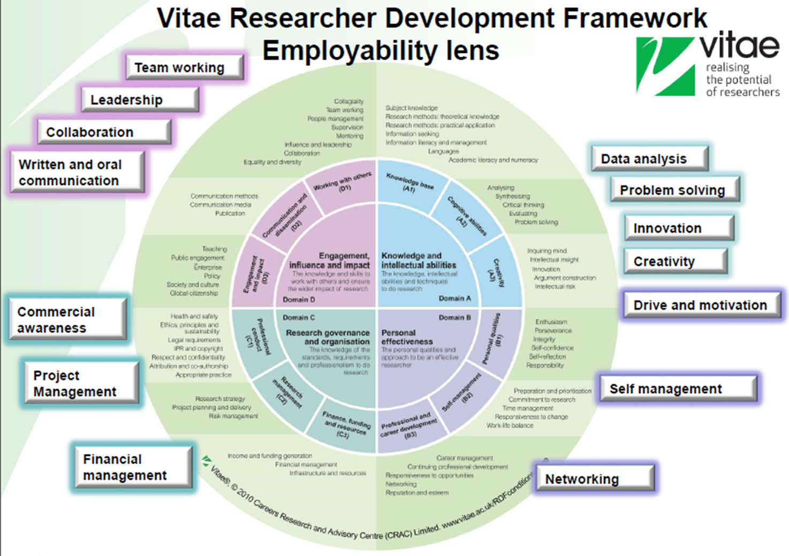
4 Placements: Requirements from students
Focus on skills & professional experiences, e.g.:
influencing others
leading, supporting, managing people
managing finances and resources
planning and organising
being customer-focused
problem-solving and decision-making
thinking and acting strategically
gaining commercial awareness
Trying your hands on marketing methods
Making a difference (community, advocacy, environmental)

Slide 17
4 Placements: Requirements from students
Source
Sourcing PIPS-hosts II:
What to look for:
Are they external to the university?
Are they willing to agree with you a 3-month project suitable for a doctoral candidate, with a training plan for the desired skills?
Are they willing to provide a mentor/supervisor and adequate contact time, desk space, interactions with members of staff?
Are they prepared to complete a PIPS Agreement (providing input on IP, Health & Safety, Insurance, Induction, etc.)? By completing the PIPS MOU, they formally confirm that the expected legal arrangements are in place for a smooth internship
Do they have a good track record in supporting their members of stuff or interns that you are aware of?

Slide 18
4 Placements: Requirements from students
Source
Further tips:
What have others done? Browse the student reports at https://biology.ed.ac.uk/eastbio/training/placements/past-pips-experiences
Agree timing with your PhD supervisor
Review skills you wish to develop, then try to match these skills with an organisation
Network for information:
Use your personal network - supervisor, other Institution staff, fellow students, family, friends
Pursue supervisor connections
Online search – LinkedIn (is your profile updated?), or established 'Internship' schemes
If stuck, ask EastBio for past hosts as we may be able to provide some ideas (but only if you're stuck!)
Book a session with a local Careers Advisor to discuss ideas
Attend a CV-briefing session to prepare a skills-based CV (have you attended the EastBio Narrative CV workshop?)

Slide 19
4 Placements: Requirements from students
Source
During your PIPS:
Seek out ways of being enterprising, use your initiative, be assertive, build your network
Maintain contact with peers and PhD supervisor
Think about what you’re learning about your career priorities
Notice how your ideas about your research project change from a different perspective/context
Keep a diary or learning log to reflect on your devolopment
Recognise when something seems to be going wrong. Depending the scale, infrom your PhD supervisor and EastBio asap!

Slide 20
5 Placements: Requirements - Process
For due diligence and quality assurance purposes, we ask students to record their plans via the following forms/steps:
Planning form (mandatory) - end of Y1 (end of September)
Do not approach a potential PIPS host before approval of your planning form!
PIPS Active Planning form (optional; to help record agreed project details at an early stage of negotiations)
PIPS Memorandum of Understanding (mandatory) - Before the start of PIPS
Placements Expenses Application (optional; eligible if PIPS is abroad or more than 50 miles from student's term-time address)
EastBio PIPS Log (encouraged, during your PIPS)
PIPS Host Organisation Feedback - student to request (mandatory) Note that this is not to assess your performance during your PIPS (although we will share any constructive input from them), but to work to build a relationship with the organisation for future placements
Student feedback to EastBio (website) Note that this concerns both your experience from your placement but also the overal process and support
Student presentation in a future Q&A session (early February) and the EastBio symposia (early June)

Slide 21
5 Placements: Requirements - Process
If your placement is abroad, you should also complete the following before your placement starts:
any relevant risk assessment requirement of your local institution (or use the EastBio pre-departure Checklist form)
Submit a Leave of Absence form to your local institution
We also encourage you to consider taking local training to help you into (as well as out of) your PIPS:
project/time management, business/enterprise or communication skills, commercialisation, specific methods you anticipate will be required, etc.
training on writing a covering letter, updating your CV, or preparing for an interview, as well as self-care, self-advocacy, and resilience
Refresher course on academic skills, writing-up, career skills, etc. upon your return from your PIPS

Slide 22
6 Placements: Practical Support
EastBio process:
Y1 Q&A session, mandatory for new students, open to supervisors
Student presentations (3 Feb, from 12:20pm), open to all students
Y2 autumn drop-in session, with student volunteers
one-to-one meeting option, with the EastBio team for individual support, on request
Frequent email reminders from the EastBio team and requests for updates (PIPS timeline)
EastBio will apply flexibilities if individual circumstances require it (with BBSRC approval)
Resources:
The EastBio Placements Guide (reviewed annually)
Separate Guidance for international fees students
Placement forms (PIPS Plan, MOU, expenses, feedback) to ensure due diligence in terms of the project feasibility and plan (reviewed annually)
EastBio templates & checklists – How to approach a PIPS host; PIPS Log; Placement abroad checklist
EastBio transferable skills training (resilience, narrative CVs, science communication, making the most of your final year), and any local we encourage you to also take before and after your placement to help you manage the transition challenges
Placement sessions at the EastBio Symposia where you can get insights from other students
After discussion with the EastBio Manager, funds can be made available to students if they experience considerable hardship during their PIPS (PIPS budget, currently earmarked for travel/accommodation).

Slide 23
7 Placements: Wellbeing Support
Starting a placement is not unlike starting a new job so we want to help make this a positive experience throughout:
Please engage properly with our process. It clarifies expectations from all partners from a very early stage.
Consider relevant training prior to and upon return from your placement to help with transition
Keep a daily log during your placement to process and self-reflect on your journey though the placement (incl. new learning, skills, contacts and achievements, areas of personal growth or any issues you may encounter along the way). Use this to feed into a broad impact statement/narrative of your PIPS project.
If not in place, request regular review meetings with your PIPS supervisor to enable adjustments on problematic processes that can be resolved by discussion
Remember that Placements are meant to expose you to skills other than research-based so embrace such opportunities as they arise
Seek input from your PhD supervisor on managing the relationship with your PIPS supervisor during the placement in a professional manner, especially if there are significant differences of approach, or challenges
If challenges arise early on in your PIPS, do not ignore them! After discussing with the EastBio team and your PhD supervisor, you can request to pause your placement, seek adjustments to the plans made - or even, at worst, discontinue it - to allow you to deal with the difficulty.
Let us know of your experience and views so that we can review and improve on our support.

Slide 24
7 Placements: Support contacts
Stay in touch with EastBio (and/or your PhD supervisor) during your placements and never hesitate to seek support as and when needed. Useful contacts below:
placements@eastscotbiodtp.ac.uk (EastBio Manager and/or Support Officer)
https://biology.ed.ac.uk/eastbio/contact-us/eastbio-dtp-committees (Training and Development Committee)
edi@eastscotbiodtp.ac.uk (EDI Student reps)
eastbio.mhfa@eastscotbiodtp.ac.uk (EastBio Mental Health group)
https://tinyurl.com/4s5wsvb8 (EastBio complaint form)
If you're facing a crisis during your placement, contact Maria.Filippakopoulou@ed.ac.uk asap!

Slide 25
8 Placements: Q&A
Thank you for listening!
Leave your feedback for the session via https://forms.office.com/e/ZvSS4NS0NQ by the 9 February
From 12:20 join EastBio students who will be presenting their placement experiences and answering your questions !
It's now time for your questions, including any submitted via the link below:
https://tinyurl.com/3zhbba7r

