Slide 1
Research in Biological Sciences
Professor Gerben van Ooijen | 14 November 2023

Slide 2
Why choose postgraduate research?
To achieve something significant by advancing knowledge to address the world’s grand challenges
Gain training in critical thinking and research
Gain a broad base in key skills (management, team work, communication, networking)
Develop a professional network for future opportunities
Personal development from working in a supportive, innovative, diverse environment on an international stage

Slide 3
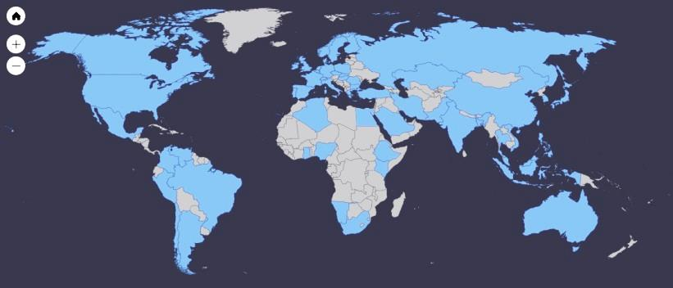
International research excellence
5th
in the UK for
Biological Sciences
£184M
active research
grants
135
Principal Investigators
393
Postgraduate Research students

Slide 4
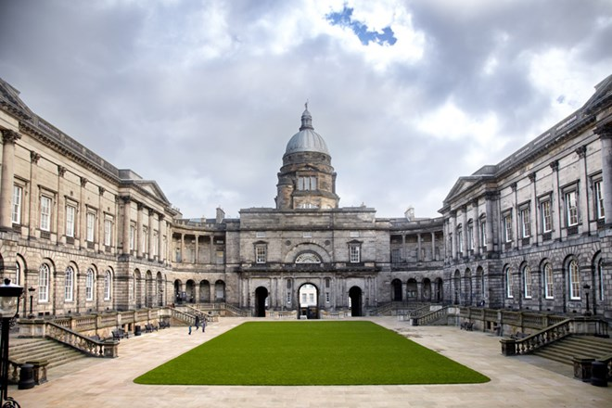
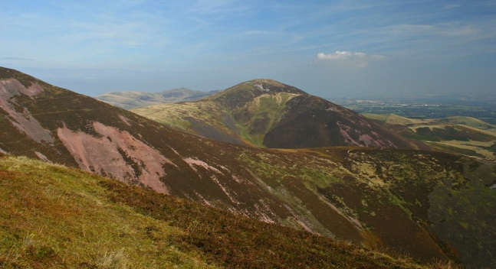
Recognised excellence in quality of life

Slide 5
Key organisation on our doorstep
Research Institutes
Charities and NGOs
Industry

Slide 6
Key organisation on our doorstep
Work in both academia & industry, e.g. Industrial CASE studentships (PIP placements)
Communicate with policy makers, e.g. policy internships
Communicate with our outreach programmes, e.g. Edinburgh Science Festival (SBS Press Gang)

Slide 7
A PhD equips you for a career in research… and much more

Slide 8
Where you can base yourself: our institutes
The Institute of Cell Biology - understanding the molecular mechanisms that underpin genomic and cellular structure and function. In particular, the stability, transmission and expression of genetic information in both prokaryotes and eukaryotes. | The Institute of Ecology and Evolution -understanding the population genetics of wild populations and of complex traits. Understanding the evolutionary causes and consequences of ecological interactions and behaviour. | The Institute of Immunology and Infection Research – encompassing fundamental immunology, immune regulation of disease and host-pathogen biology. Cross-disciplinary approaches to address today’s challenges in global health.
The Institute of Molecular Plant Sciences – research from molecular to whole-plant scales addressing the global challenges of food security, green technology and climate change. | The Institute of Stem Cell Research – scientists and clinicians study stem cells, disease and tissue repair to advance human health as part of the Centre for Regenerative Medicine. | The Institute of Quantitative Biology, Biotechnology and Biochemistry– using Systems and Synthetic Biology approaches as well as structural studies to address fundamental biology questions and practical biotech solutions.

Slide 9
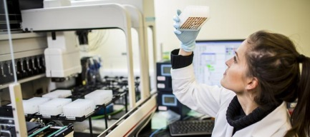
Additional support: the Graduate School
The Graduate School oversees the progression of all students registered to study for a PhD or MSc by research degrees in the School of Biological Sciences.
Postgraduate students
Institute
postgraduate advisors
Institute
student reps
SBS Graduate School

Slide 10
Recognised excellence in research training
We host several Doctoral Training Programmes eg. EASTBIO, NERC E4, MRC Precision Medicine
Wellcome Trust PhD in Hosts, Pathogens & Global Health
Wellcome Trust PhD in Integrative Cell Mechanisms
Wellcome Trust PhD in One Health Models of Disease
Competitively won based on excellence in PhD training offered
The Darwin Trust
School of Biological Sciences Scholarships
University Scholarships
External organisation PhDs
Individual supervisor projects
Supported by

Slide 11
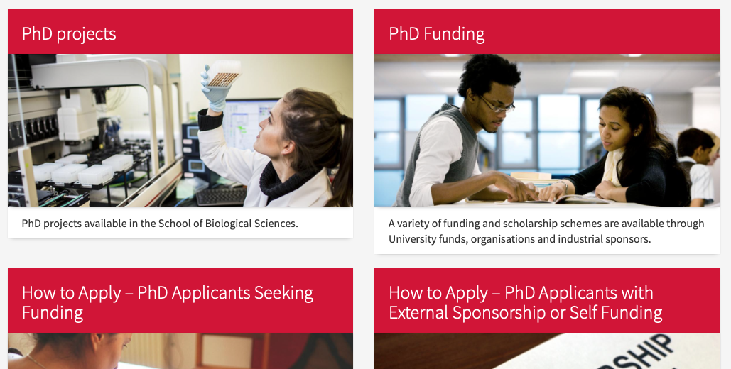
Where do I start?
www.ed.ac.uk/biology/study-with-us/postgraduate-research/apply-for-a-phd

Slide 12
Where do I start?
Select your project from our online list of PhD Projects.
Click 'how to apply' on the advertised PhD project to complete our eligibility checklist - for each project if applying for more than one.
You will then apply through the University’s online application system – EUCLID.
Applying for funding is a separate process - a list of suggested funding schemes is provided during the eligibility checklist. You can also view the full list of funding schemes.

Slide 13
Where do I start?
Confirm our entry requirements:
At least 2.1 Honours degree or its international equivalent
Contact supervisor(s):
Browse available PhD projects & staff profiles –contact staff who do what you’re interested in
Discuss potential projects / application with prospective supervisor(s) – PhD & MScR
Apply online – first closing date is 27 November 2023:
Specify supervisor & project
Upload documents (proposal, transcripts, references, etc.)
Funding information

Slide 14
What happens next?
Supervisors review applications and forward to Interview panel:
All supervisors can propose one or two students, depending on funding body
Shortlisting for interview:
Panel looks at academic record, experience, motivation
Attend interview:
a chance to talk about your previous research and your ambitions
Offers made as early as possible
but can take a little while
Start of projects in our School is 1 October 2024

Slide 15
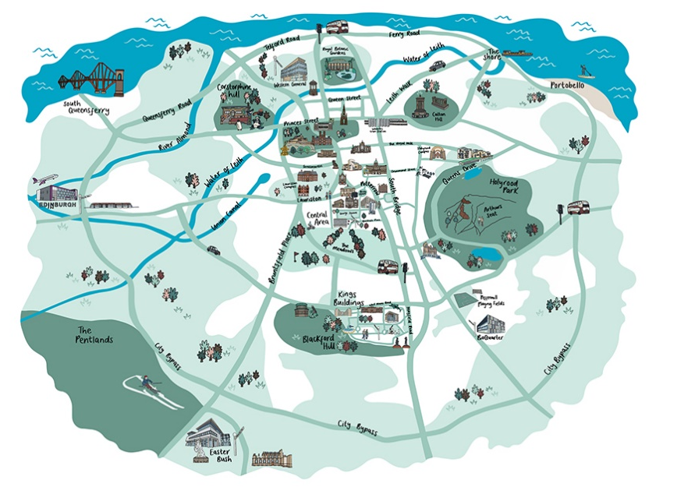
What you can do now…
edin.ac/student-chat-pg
virtualvisits.ed.ac.uk/pg

Slide 16
What you can do now…
Contact potential supervisors.
Get in touch if you have questions on application process: Grad.Biol@ed.ac.uk
www.ed.ac.uk/biology/prospective-students/postgraduate-research/apply-for-a-phd
Welcome to Edinburgh

Slide 17
Professor Gerben van Ooijen
Grad.Biol@ed.ac.uk

