Slide 1
Doctoral internships FUN TIMES BUT WAS IT A GOOD LEARNING EXPERIENCE?

Slide 5
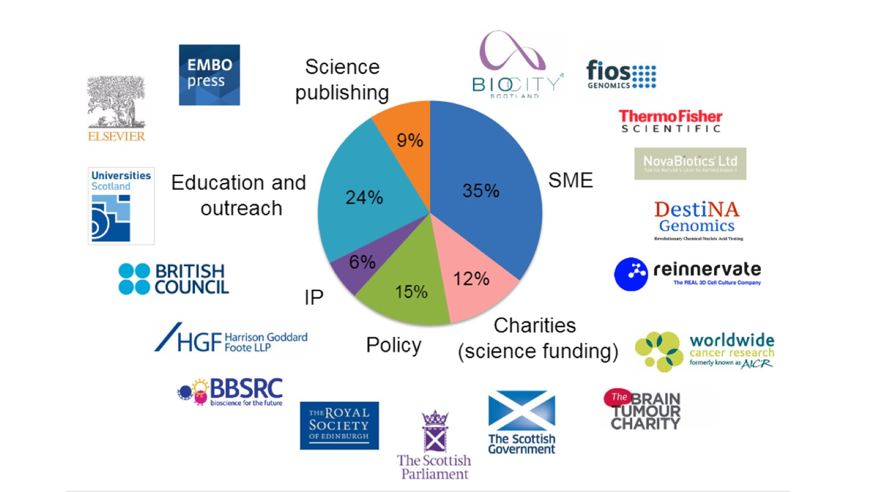

Slide 7
Less Tangible Outcomes

Slide 11
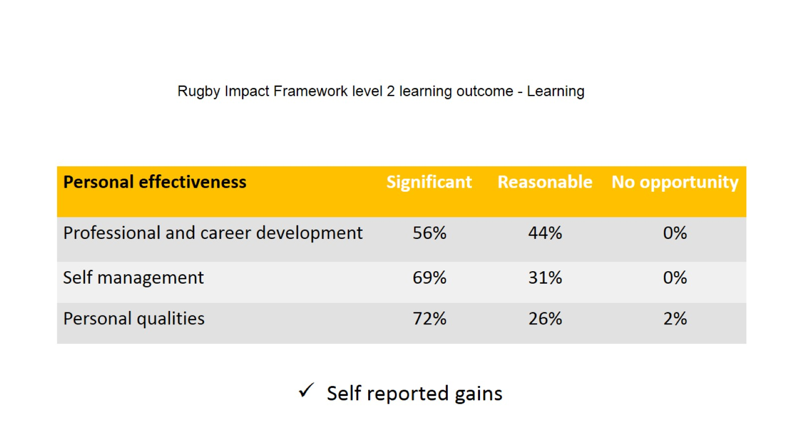

Slide 16
Personal growth and behavioural change

Slide 17
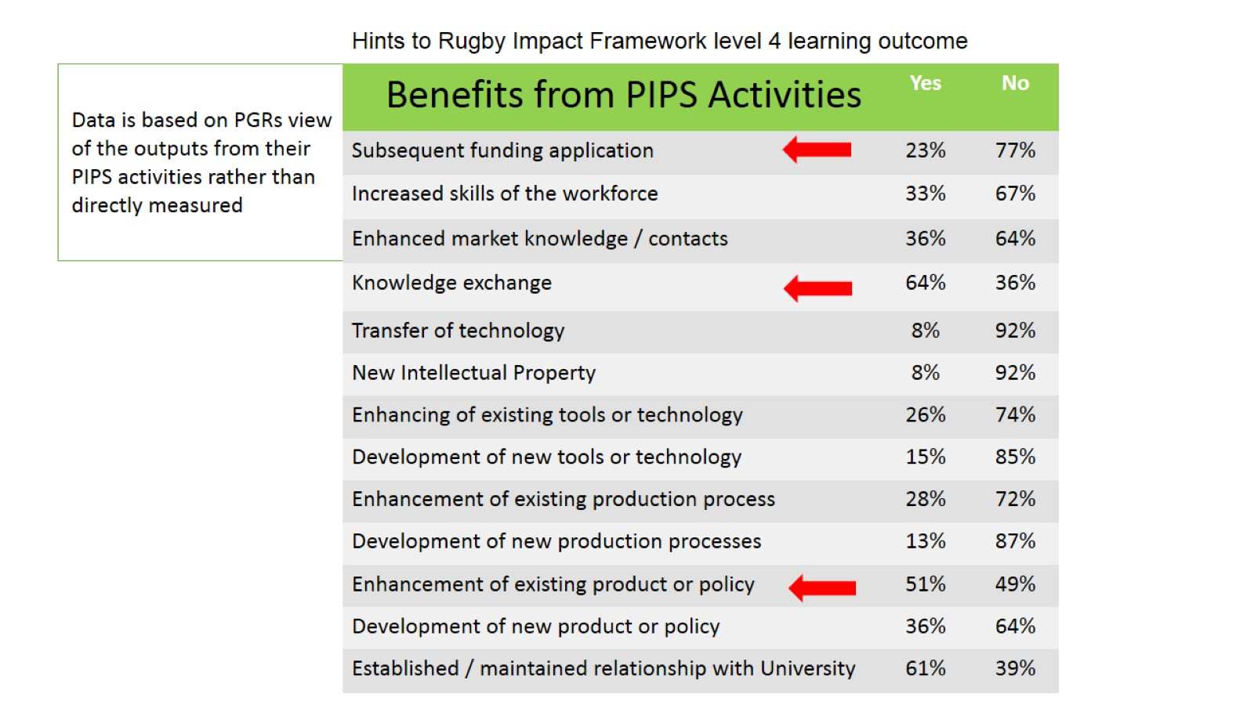

Slide 22
Conclusion

